Slide 1
This is a marketing communication. Please refer to the Key Information Document (KID) before making any final investment decisions.
Allianz Technology
Trust PLC
Annual General Meeting
April 2024
Mike Seidenberg, Lead Portfolio Manager
A ranking, a rating or an award provides no indicator of future performance and is not constant over time

Slide 2
Agenda
01 | Overview & Investment Team
02 | Process, Performance & Positioning
03 | Technology Growth Drivers

Slide 3
Overview & Investment Team
01

Slide 4

Allianz Technology Trust: Capitalizing on technology expertise
“We believe investing in technology investments is more of a “winner’s game” than a “loser’s game.” Opportunities within a rapidly changing technology landscape can be identified by stockpicking, augmented by our use of Grassroots Research® and location at the heart of Silicon Valley providing a distinct advantage.” Michael Seidenberg, Lead Portfolio Manager
1 | Proven track record with multi-decades of experience and outperformance history
2 | Consistent investment process focused on stock selection and risk management
3 | Proximity to Silicon Valley innovation hub provides an edge over most managers
Past performance does not predict future returns.

Slide 5
Key Features
Our team-based approach is driven by fundamental research, seeking long-term capital appreciation through the discovery of innovative technology companies and building a portfolio with a focus on opportunities in emerging mid and large-cap companies
Assets Under Management | Allianz Technology Trust | Global Technology Team | Voya San Francisco Technology Teams
Total Assets | £1.5 billion | £5.1 billion | £16.6 billion
Source: Voya IM, as at 31 March 2024. From 25 July 2022, discretionary portfolio management services formerly provided to Allianz Technology Trust PLC (the “Company”) by Allianz Global Investors (“AllianzGI”) have been delegated to Voya Investment Management Co. LLC (“Voya IM”). All members of the former AllianzGI Global Technology Team transferred to Voya IM and continue to manage the Company’s portfolio. It is anticipated that there will be no change to the investment process. AllianzGI will remain the Company’s AIFM (Alternative Investment Fund Manager), providing company secretarial, administration and sales and marketing services.

Slide 6





The Voya IM Team managing Allianz Technology Trust (“ATT”)
The portfolio management team employs a collaborative investment management process with each team member offering complementary skills to enhance the decision-making process.
The team’s combined investment industry experience is 116 years with an average of 23 years.
Mike Seidenberg Lead Portfolio Manager 23 years experience | Erik Swords Portfolio Manager Head of Global Technology 24 years experience | Justin Sumner, CFA Equity Analyst 27 years experience | Danny Su Equity Analyst 25 years experience | John Coyle Equity Analyst 17 years experience
Investment Team Supported by Broad Firm Resources
Fundamental & Thematic Research
Quantitative & ESG Research
Grassroots Research®*
Risk Management, Trading Operations & Compliance
Silicon Valley Boots on the Ground Expertise
Source: Voya IM, as at 31 March 2024. From 25 July 2022, discretionary portfolio management services formerly provided to Allianz Technology Trust PLC (the “Company”) by Allianz Global Investors (“AllianzGI”) have been delegated to Voya Investment Management Co. LLC (“Voya IM”). All members of the former AllianzGI Global Technology Team transferred to Voya IM and continue to manage the Company’s portfolio. It is anticipated that there will be no change to the investment process. AllianzGI will remain the Company’s AIFM (Alternative Investment Fund Manager), providing company secretarial, administration and sales and marketing services. Grassroots® Research is a division of Allianz Global Investors that commissions investigative market research for asset management professionals. Research data used to generate Grassroots® Research reports are received from independent third-party contractors who supply research that, subject to applicable laws and regulations, may be paid for by commissions generated by trades executed on behalf of clients.

Slide 7










The Voya IM San Francisco Technology teams
The San Francisco technology teams have decades of experience covering the technology sector
Investment team
Strategies managed
Allianz Technology Trust
Global Technology
Michael Seidenberg (23)
Lead Portfolio Manager
Erik Swords (24)
Senior Portfolio Manager
Sebastian Thomas, CFA (28)
Senior Portfolio Manager/Analyst
Global Cyber Security
Global Artificial Intelligence
Cloud Computing
Justin Sumner, CFA (27)
Senior Portfolio Manager/Analyst
Danny Su (25)
Portfolio Manager/Analyst
James Chen, CFA (31)
Portfolio Manager/Analyst
Stephen Jue (24)
Portfolio Manager/Analyst
Future Generations
Innovative Decarbonization
Intelligent Cities
John Coyle (17)
Research Analyst
Stephen McDonald, CFA (17)
Research Analyst
Stacey Worman, PhD (6)
Research Analyst
AI Opportunities CEF
Source: Voya IM, as at 31 March 2024. Numbers in parentheses reflect years of industry experience and are updated each quarter. From 25 July 2022, discretionary portfolio management services formerly provided to Allianz Technology Trust PLC (the “Company”) by Allianz Global Investors (“AllianzGI”) have been delegated to Voya Investment Management Co. LLC (“Voya IM”). All members of the former AllianzGI Global Technology Team transferred to Voya IM and continue to manage the Company’s portfolio. It is anticipated that there will be no change to the investment process. AllianzGI will remain the Company’s AIFM (Alternative Investment Fund Manager), providing company secretarial, administration and sales and marketing services.

Slide 8
Process, Performance
& Positioning
02

Slide 9

Allianz Technology Trust: Investment process
Investment universe
Global technology stocks
Idea generation
Identify major trends via internal research, conferences, company management, sell-side and Grassroots®
Stock selection
Pinpoint attractive companies with sustained earnings growth, market leadership, barriers to entry, balance sheet strength, high quality management, etc.
Portfolio construction
Determine position sizing, seeking diversification and growth vs. valuation to drive alpha potential
Risk management
Daily risk monitoring by investment team combined with independent firm-wide analysis & oversight
Final portfolio
Conviction portfolio of 40 - 70 stocks
During any given stage of the investment process, the selection criteria may vary from those shown above. The diagrams and statements above reflect the typical investment process applied to this strategy. At any given time other criteria may affect the investment process. Grassroots Research® and Grassroots® are registered trademarks of Allianz Global Investors GmbH (AllianzGI) and are used by Voya Investment Management (Voya IM) pursuant to licensing agreement with AllianzGI. Research data used to generate Grassroots® reports may be paid for by commissions generated by trades executed on behalf of clients.

Slide 10
A Holistic Approach to Environmental, Social & Governance (ESG) Integration
Voya Investment Management’s symbiotic interaction of quantitative, fundamental and stewardship teams all working together in the service of generating alpha (excess return versus benchmark)
Fundamental
Engages in meaningful dialogue with companies and evaluates all issues that inform our investment decisions, including ESG considerations
Analyst Insight
Scorecards
Company Dialogue
Enriching Alpha Through ESG
Active
Ownership
Quantitative
Aspires to improve the long-term sustainability of the companies in which we invest by promoting ESG best practices through our proxy voting and engagement activities
V-Score
EMI Features
Tailored Signals
Researches systematic ways to generate alpha including through ESG-related signals
Engagement
Proxy Voting
Best Practices
Source: Voya Investment Management, March 31, 2024. During any given stage of the investment process, the selection criteria may vary from those shown above. The diagrams and statements above reflect the typical investment process applied to this strategy. At any given time other criteria may affect the investment process.

Slide 11
Magnificent 7 stocks driving market returns over last year
The overall market return has been dominated by a handful of mega-capitalisation stocks
Trailing 12 months returns
Source: Bloomberg, comparing the Bloomberg Magnificent 7 Index, which consists of Alphabet (GOOGL), Amazon (AMZN), Apple (AAPL), Meta (META), Microsoft (MSFT), Nvidia (NVDA) and Tesla (TSLA), to the Dow Jones World Technology Index, using weekly returns in USD from April 1, 2023 to March 31, 2024. Past performance is not indicative of future results.

Slide 12
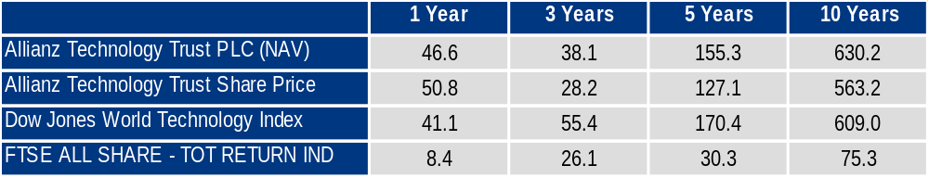
Strong relative and absolute performance of ATT
Past performance does not predict future returns.
Source: AllianzGI, as at 31 March 2024. Cumulative total returns in GBP.

Slide 13
Top 10 holdings
Allianz Technology Trust vs. Dow Jones World Technology Index
As of March 31, 2024
Security name | Portfolio % | Benchmark % | GICS industry | GICS sub-industry
NVIDIA Corporation | 9.5 | 11.0 | Semiconductors & Semiconductor Equipment | Semiconductors
Microsoft Corporation | 8.1 | 15.4 | Software | Systems Software
Meta Platforms Inc | 6.8 | 5.3 | Interactive Media & Services | Interactive Media & Services
Apple Inc. | 4.8 | 12.3 | Technology Hardware, Storage & Peripherals | Technology Hardware, Storage & Peripherals
Broadcom Inc. | 4.2 | 2.9 | Semiconductors & Semiconductor Equipment | Semiconductors
Amazon.com, Inc. | 4.2 | -- | Broadline Retail | Broadline Retail
Alphabet Inc. | 3.5 | 8.1 | Interactive Media & Services | Interactive Media & Services
Lam Research Corporation | 3.4 | 0.6 | Semiconductors & Semiconductor Equipment | Semiconductor Equipment
Micron Technology, Inc. | 3.2 | 0.6 | Semiconductors & Semiconductor Equipment | Semiconductors
Monolithic Power Systems, Inc. | 2.3 | 0.2 | Semiconductors & Semiconductor Equipment | Semiconductors
Source Voya IM. The 10 holdings are subject to change and will vary over time. References to specific securities and their issues are examples of securities held and not intended to be, and should not be interpreted as an offer, solicitation or recommendation to purchase or sell any financial instrument, an indication that the purchase of such securities was or will be profitable, or representative of the composition or performance of the portfolio. The securities identified do not represent all securities purchased, sold or recommended for client accounts. Actual holdings will vary for each client and there is no guarantee that a particular client’s account will have the same characteristics as described above. The account presented was selected by the firm as a representative account deemed to best represent this management style. The Global Industry Classifications Standard (GICS ®) is the exclusive property and a service mark of Morgan Stanley Capital International Inc. and Standard & Poor’s, a division of The McGraw-Hill Companies, Inc. See additional disclosure at the end of this presentation.

Slide 14
The portfolio has greater exposure to mid cap growth stocks
High growth companies tend to be smaller sized companies
We believe the higher growth companies in the portfolio are well-positioned to deliver robust long-term growth
Source Voya IM. Portfolio weights are as of 31 March 2024.
Mega Cap: $200B and above; Large Cap: $30B to $200B; Mid Cap: $5B to $30B; Small Cap: Below $5B; The chart above does not include cash held in the portfolio. This is for guidance only and not indicative of future allocation.

Slide 15
Portfolio characteristics relative to the benchmark
ATT Portfolio vs. Dow Jones World Technology Index
As of 31 March 2024
 | Portfolio | Benchmark
Number of Holdings | 42 | 1,042
Dividend Yield (%) | 0.4 | 0.7
Weighted Average Market Cap (bn) | £868.7 | £967.9
Weighted Median Market Cap (bn) | £172.4 | £805.7
Earnings Per Share Growth
Earnings Growth (Last 3 Years) | 33.3 | 23.6
Earnings Growth (Last 12 Months) | 35.0 | 13.8
Earnings Growth (Next 12 Months) | 25.6 | 22.2
Earnings Growth (Next 3 Years) | 22.8 | 18.4
Price-to-Earnings
Price/Earnings (Last 12 Months) | 44.1 | 33.4
Price/Earnings (Next 12 Months) | 38.3 | 27.7
Price/Earnings (Next 12 mo.) to Growth (Next 3-5 years) | 1.75 | 1.66
The portfolio’s earnings growth is significantly higher compared to the benchmark
Higher earnings growth warrants higher portfolio Price-to-Earnings (P/E) multiples
We seek to own companies that can deliver sustainable earnings growth over time, which typically rewards investors over the long term
Source: Voya IM, as at 31 March 2024. This is for guidance only and not indicative of future allocation. Weighted median market capitalisation gives the level where half of the portfolio assets are invested in stocks that are larger than the median market cap, and half in stocks that are smaller..

Slide 16
Technology Growth Drivers
03

Slide 17
Why technology today?
Types of Technology Companies | Characteristics of Group
High-growth, innovators | Secular growth Emerging/transformative areas within technology Current and projected sales growth >20% Long-term price targets based on sustained growth over investment horizon indicate healthy upside
Reasonable valuation relative to growth (GARP – growth at a reasonable price) | Secular growth Established markets but still huge expansion potential Current and projected sales/earnings growth >15% Valued on price multiple-to-growth basis Price appreciation as earnings/cash flow growth more-than-compensates for multiple contraction
Attractively valued with optionality | Total return Technology incumbents who can emerge again as growth companies Consolidators with cost and pricing discipline Mid to Mega capitalization Aggressive capital return companies Companies responding to activist pressures for better stock performance
Balanced risk-adjusted performance
Different groups emphasized with different market environments
The Technology Lifecycle
Source: Voya IM. As of March 31, 2024

Slide 18
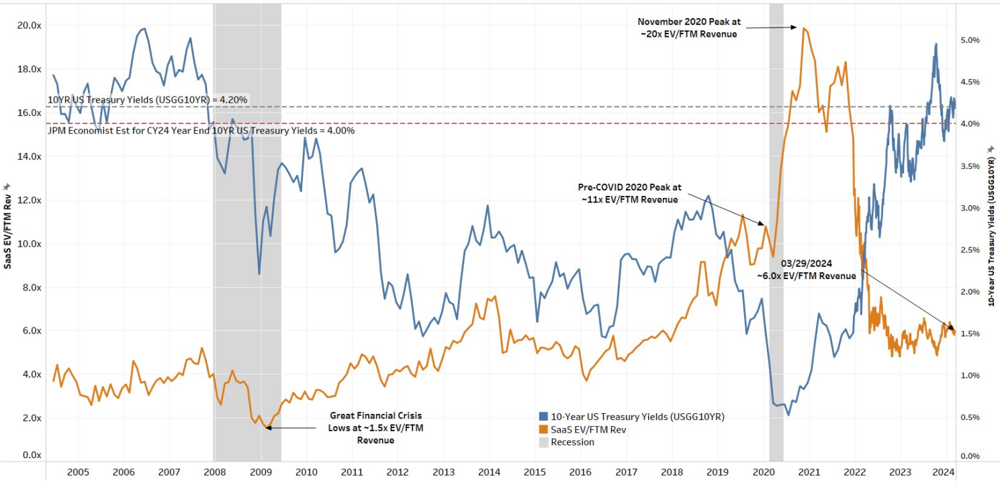
Software valuations are more reasonable post-pandemic
Software multiples typically bottom before revenue growth
This chart looks at the average EV/FTM sales multiple for ~120 SaaS companies since mid-2004 charted as the orange line. Not all companies were publicly traded for the entire history of this chart. Up to 12/31/2021, data was updated on the last day of each month. After 12/31/2021, the chart is updated bi-weekly. The chart also shows the US 10YR yield charted as the blue line. As of April 1, 2024 report. Source: J.P. Morgan, Bloomberg Finance L.P.

Slide 19
Artificial intelligence (AI) innovation is here to stay
In the words of AI adopters…
77%
73%
71%
64%
Expect generative AI to have the largest impact on their businesses out of all emerging technologies
Believe generative AI will increase workforce productivity
Will implement their first generative AI solution within the next two years
Believe generative AI will help their business gain a competitive advantage
Source: “Generative AI: From buzz to business value,” KPMG 2023 Survey
Notes:
Generative AI: From buzz to business value (kpmg.com)

Slide 20
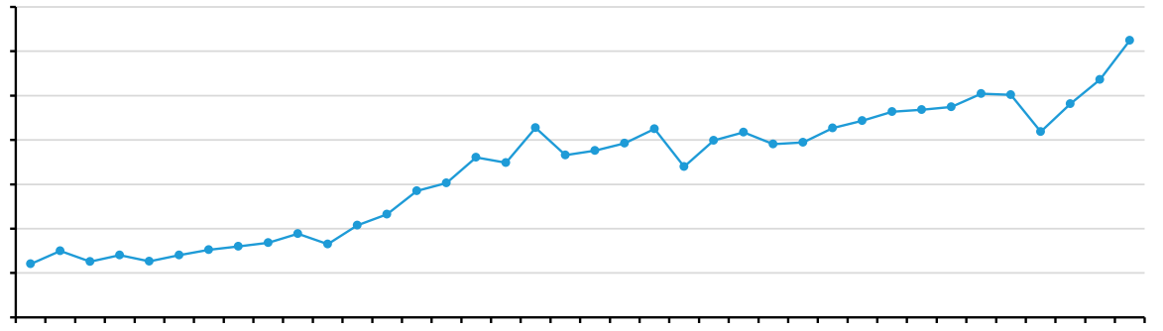
Hyperscale capital expenditure spending reflective of secular AI growth
Super 7 Capital Expenditure Spending
$35
$30
$25
$20
$15
$10
$5
$0
Super-7 Capex ($ Billions)
Q215 | Q315 | Q415 | Q116 | Q216 | Q316 | Q416 | Q117 | Q217 | Q317 | Q417 | Q118 | Q218 | Q318 | Q418 | Q119 | Q219 | Q319 | Q419 | Q120 | Q220 | Q320 | Q420 | Q121 | Q221 | Q321 | Q421 | Q122 | Q222 | Q322 | Q422 | Q123 | Q223 | Q323 | Q423 | Q124 | Q224 | Q324
Source: Company reports, Bernstein estimates and analysis, as of 14 March 2024. Super 7 refers to Amazon, Meta Platforms, Google, Microsoft, Baidu, Alibaba, and Tencent.

Slide 21
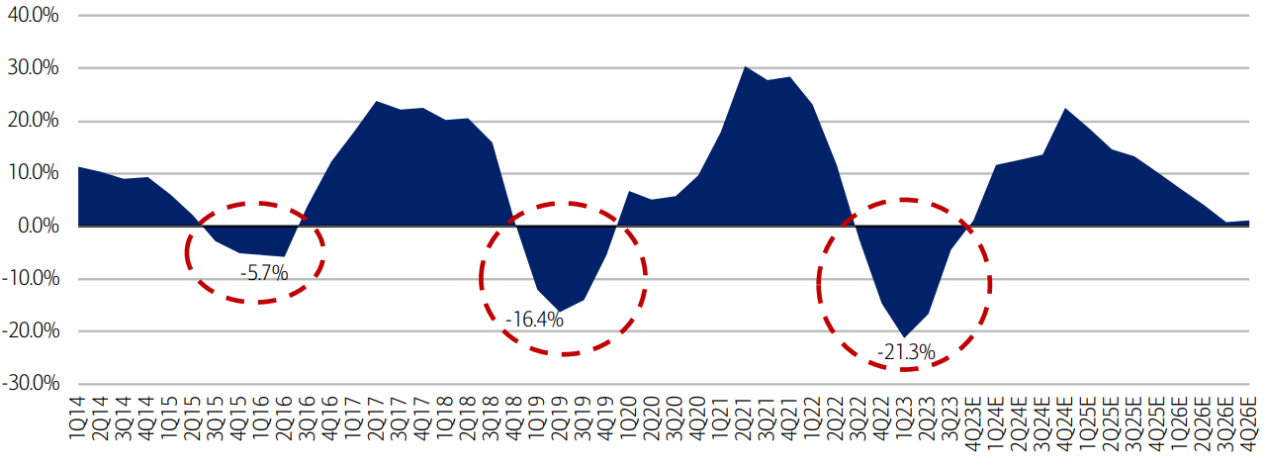
Semiconductor demand poised to continue accelerating
We expect we are at the start of the next upcycle, which could last through the middle of 2026
Today
2014 | 2015 | 2016 | 2017 | 2018 | 2019 | 2020 | 2021 | 2022 | 2023 | 2024 (E) | 2025 (E) | 2026 (E)
Source: BofA Global Research, SIA, 2024 Playbook: bumpy yet bountiful, focus on quality in Cloud, Cars, Complexity report, as of December 2023. Estimated figures for 2024, 2025 and 2026. The statements contained herein may include statements of future expectations and other forward-looking statements that are based on management's current views and assumptions and involve known and unknown risks and uncertainties that could cause actual results, performance or events to differ materially from those expressed or implied in such statements. We assume no obligation to update any forward-looking statement.

Slide 22
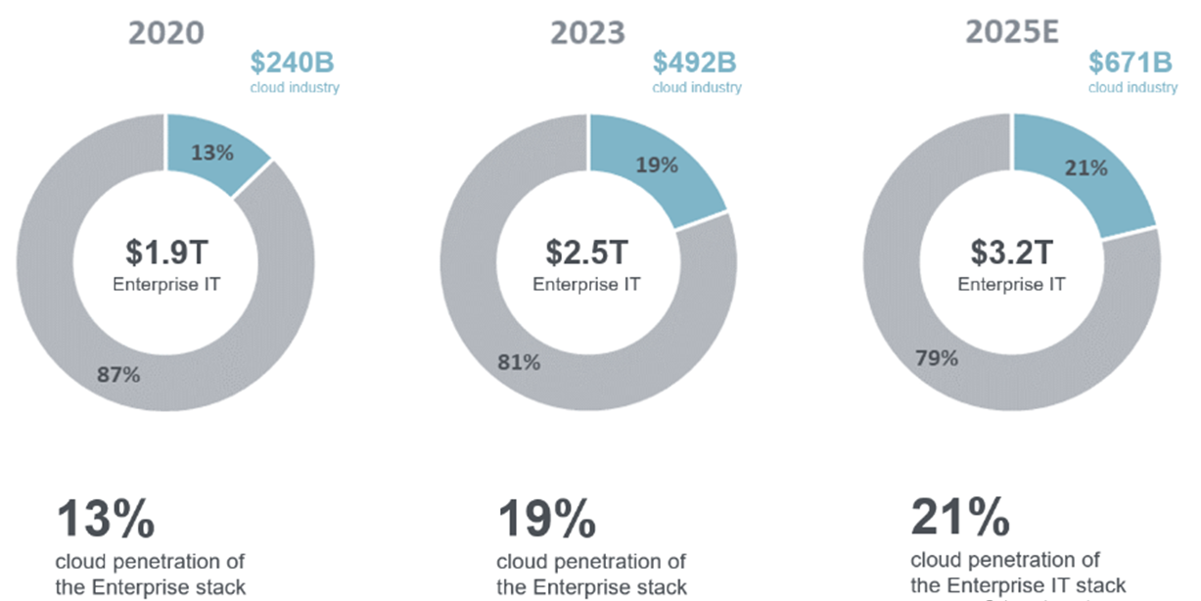
Cloud computing offers sustainable secular tailwinds
Total cloud penetration is steadily growing
$240B
Cloud Industry
$492B
Cloud Industry
$671B
Cloud Industry
Source: Gartner, FactSet, Piper Sandler Estimates, December 31, 2023.

Slide 23

Cybersecurity is a requirement in the digital world
ADMASTER-STAMP!20220929-2449836-7668460
The cyber security market is expected to grow at a rate of 11.6% p.a. until 2030¹
Investment in innovation grows: the number of leaders spending more than 20 percent of IT budgets on advanced technology investments has doubled in the last three years.²
69% say that staying ahead of attackers is a constant battle,
and that the cost is unsustainable.²
$539.8 B
Top areas where security leaders are increasing their investment³
2020 | 2030
Sources: ¹ Businesswire: Global Cyber Security Market (2020 to 2030) - by Component, Security Type, Deployment, Enterprise, Use Case and Industry - ResearchAndMarkets.com, November 2020 ² Accenture security, Innovate for Cyber Resilience, Third Annual State of Cyber Resilience, 2020. ³ Team8: 2021 Cybersecurity Brief.
Notes:
https://www.businesswire.com/news/home/20201119005835/en/Global-Cyber-Security-Market-2020-to-2030---by-Component-Security-Type-Deployment-Enterprise-Use-Case-and-Industry---ResearchAndMarkets.com

Slide 24
Stock Example
Hubspot (HUBS)
Hubspot is a next generation customer relationship management (CRM) platform. Key competitive advantage driven by unified sales, service, and content solutions targeted at SMB space.
Hubspot investment thesis:
End markets underspent post pandemic thus thought the business could accelerate.
New CEO making strides improving their go to market strategy via better focus on partner costs. We had exposure to her from her Workday employment thus gave comfort knowing she would have impact.
Unified data is a long-term competitive advantage across many end markets but especially in the SMB where many organizations have employees doing multiple jobs (i.e. a single employee responsible to for content marketing and sales efforts).
Focus on improving operating margins and profitability post pandemic.
Holdings in the Allianz Technology Trust portfolio as of 31 March 2024: Hubspot 1.7%. Securities mentioned in this document are for illustrative purposes only and do not constitute a recommendation or solicitation to buy or sell any particular security. These securities will not necessarily be comprised in the portfolio by the time this document is disclosed or at any other subsequent date.

Slide 25
Stock Example
Monolithic Power Systems (MPWR)
A leading semiconductor designer, developer and marketer of high-performance power systems, seeking to reduce total energy consumption in its customers' systems with green, practical and compact solutions.
Monolithic Power Systems investment thesis:
Superior design and production process with customers resulting in long term relationships and benefits from “cost down” process and next generation design in process.
Company has gained share in both up and down cycles.
In the last 4 down turns (2009, 2012, 2019, and 2023), the company was able to outgrow the semiconductor market by double digits.
Well-diversified end markets.
Holdings in the Allianz Technology Trust portfolio as of 31 March 2024: Monolithic Power Systems 2.4%. Securities mentioned in this document are for illustrative purposes only and do not constitute a recommendation or solicitation to buy or sell any particular security. These securities will not necessarily be comprised in the portfolio by the time this document is disclosed or at any other subsequent date.

Slide 26
Stock Example
Meta Platforms (META)
Leading social media company with a number of properties under their umbrella (Facebook, Instagram, and WhatsApp).
Meta Platforms investment thesis:
Good example of the “Lifecycle of Technology” investing.
First met the Company while private.
Recognized the difficult they were facing with competitive pressures via use of Grassroots Research in most of ’22.
Identified product improvements in Instagram in late ’22.
Valuation plus primary research gave us conviction to make this large position for the Trust.
Holdings in the Allianz Technology Trust portfolio as of 31 March 2024: Meta Platforms 6.8%. Securities mentioned in this document are for illustrative purposes only and do not constitute a recommendation or solicitation to buy or sell any particular security. These securities will not necessarily be comprised in the portfolio by the time this document is disclosed or at any other subsequent date.

Slide 27
Strategy designed to perform
Multi-pronged investment identification | Traditional stock selection is driven by boots on the ground expertise in Silicon Valley, complemented by Grassroots® Research
Risk-focused process | Our approach seeks to mitigate “blow-up” risk by buying market leaders where the probability of positive total return potential may be higher
Diversification is key | We view diversification as critical to navigate somewhat unpredictable sub-sector rotation
Grassroots Research® and Grassroots® are registered trademarks of Allianz Global Investors GmbH (AllianzGI) and are used by Voya Investment Management (Voya IM) pursuant to licensing agreement with AllianzGI. Research data used to generate Grassroots® reports may be paid for by commissions generated by trades executed on behalf of clients. A performance of the strategy is not guaranteed and losses remain possible.

Slide 28
Appendix

Slide 29
Industry & country weights
Allianz Technology Trust vs. Dow Jones World Technology Index
As of March 31, 2024
Industry weightings (%)
Country weightings (%)
Source Voya IM, as at 31 March 2024. Top ten countries and sectors by representative account weight. The tables above do not include cash held in the representative account. The Global Industry Classifications Standard (GICS ®) is the exclusive property and a service mark of Morgan Stanley Capital International Inc. and Standard & Poor’s, a division of The McGraw-Hill Companies, Inc. See additional disclosure at the end of this presentation. This is for guidance only and not indicative of future allocation.

Slide 30
Returns have beaten our benchmark thanks to stock selection
1 year industry attribution: Allianz Technology Trust vs. Dow Jones World Technology
 | Port. Average Weight | Port. Total Return | Port. Contrib. To Return | Bench. Average Weight | Bench. Total Return | Bench. Contrib. To Return | Allocation Effect | Selection Effect | Total Effect
Total | 100.0 | 50.6 | 50.6 | 100.0 | 44.2 | 44.2 | -0.4 | 6.8 | 6.4
Technology Hardware Storage & Peripherals | 7.9 | -4.1 | -0.4 | 17.7 | -5.4 | -1.1 | 2.2 | 0.1 | 2.3
Semiconductors & Semiconductor Equipment | 32.4 | 36.1 | 10.4 | 29.4 | 33.6 | 8.9 | 0.6 | 0.5 | 1.2
Communications Equipment | 1.6 | 24.3 | 0.4 | 2.2 | 5.5 | 0.1 | 0.1 | 0.3 | 0.4
Interactive Media & Services | 10.4 | 18.7 | 1.9 | 15.3 | 15.8 | 2.4 | -0.1 | 0.3 | 0.2
Ground Transportation | 0.6 | 26.2 | 0.1 | -- | -- | -- | 0.1 | -- | 0.1
Electronic Equipment Instruments & Components | -- | -- | -- | 0.4 | 7.9 | 0.0 | 0.0 | -- | 0.0
Entertainment | -- | -- | -- | 0.3 | 25.9 | 0.1 | 0.0 | -- | 0.0
Media | 0.2 | -3.1 | 0.0 | -- | -- | -- | -0.1 | -- | -0.1
Broadline Retail | 5.7 | 12.4 | 0.7 | -- | -- | -- | -0.1 | -- | -0.1
Hotels Restaurants & Leisure | 0.7 | -9.1 | -0.1 | 0.2 | -10.0 | 0.0 | -0.2 | 0.0 | -0.2
[Cash] | 2.3 | 1.6 | 0.1 | -- | -- | -- | -0.3 | -- | -0.3
Software | 29.8 | 9.4 | 3.1 | 29.2 | 10.4 | 3.2 | 0.0 | -0.3 | -0.3
IT Services | 8.4 | -1.0 | -0.1 | 5.1 | 2.5 | 0.2 | -0.4 | -0.4 | -0.7
Source: FactSet, showing annual performance in USD from April 1, 2023 to March 31, 2024. Industry weights with less than 10 bps weight have been excluded due to space limitations. Past performance is not indicative of future results. This is for guidance only and not indicative of future allocation.

Slide 31
Mega-cap and mid-cap names have driven results
1 year market cap attribution: Allianz Technology Trust vs. Dow Jones World Technology
 | Port. Average Weight | Port. Total Return | Port. Contrib. To Return | Bench. Average Weight | Bench. Total Return | Bench. Contrib. To Return | Allocation Effect | Selection Effect | Total Effect
Total | 100.0 | 50.6 | 50.6 | 100.0 | 44.2 | 44.2 | -1.2 | 7.6 | 6.4
Mega Cap: > $200B | 50.9 | 66.2 | 31.9 | 66.4 | 49.3 | 32.7 | -0.8 | 7.8 | 7.0
Large Cap: $30B - $200B | 33.9 | 36.1 | 11.1 | 20.4 | 42.9 | 8.4 | -0.3 | -3.4 | -3.6
Mid Cap: $5B - $30B | 12.9 | 39.6 | 7.2 | 10.1 | 27.6 | 2.6 | -0.2 | 2.9 | 2.7
Small Cap: <5B | 0.3 | 58.9 | 0.3 | 3.1 | 15.3 | 0.5 | 0.9 | 0.3 | 1.2
[Cash] | 2.0 | 5.8 | 0.1 | -- | -- | -- | -0.9 | -- | -0.9
Source: FactSet, showing annual performance in USD before trading, market impact and fees from April 1, 2023 to March 31, 2024. Mega Cap: $200B and above; Large Cap: $30B to $200B; Mid Cap: $5B to $30B; Small Cap: Below $5B; The chart above does not include cash held in the portfolio. Past performance is not indicative of future results. This is for guidance only and not indicative of future allocation.

Slide 32
Top 10 contributors have outpaced detractors
1 year security attribution: Allianz Technology Trust vs. Dow Jones World Technology
Best |  | Average Weight |  |  |  | Stock |  | Active
Name |  | Port | Bmk | Rel |  | Return % |  | Contr
Apple Inc. |  | 7.4 | 16.0 | -8.6 |  | 5 |  | 407 bps
NVIDIA Corporation |  | 8.3 | 7.0 | 1.3 |  | 225 |  | 138 bps
Tencent Holdings Ltd. |  | -- | 1.5 | -1.5 |  | -20 |  | 135 bps
CrowdStrike Holdings, Inc. Class A |  | 2.0 | 0.3 | 1.7 |  | 134 |  | 105 bps
Micron Technology, Inc. |  | 2.0 | 0.5 | 1.5 |  | 97 |  | 97 bps
Meta Platforms Inc Class A |  | 6.6 | 4.3 | 2.3 |  | 129 |  | 83 bps
Cisco Systems, Inc. |  | -- | 1.2 | -1.2 |  | -2 |  | 67 bps
Lam Research Corporation |  | 2.4 | 0.5 | 1.8 |  | 85 |  | 66 bps
Amazon.com, Inc. |  | 3.2 | -- | 3.2 |  | 75 |  | 59 bps
Texas Instruments Incorporated |  | -- | 0.9 | -0.9 |  | -3 |  | 55 bps
Best 10 |  |  |  |  |  | +1212 bps |  | 1212 bp
Worst |  | Average Weight |  |  |  | Stock |  | Active
Name |  | Port | Bmk | Rel |  | Return % |  | Contr
ON Semiconductor Corporation |  | 1.3 | 0.2 | 1.10 |  | -10 |  | -104 bps
Okta, Inc. Class A |  | 0.9 | 0.1 | 0.78 |  | 8 |  | -89 bps
MercadoLibre, Inc. |  | 1.7 | -- | 1.68 |  | 14 |  | -74 bps
ASML Holding NV ADR |  | 1.0 | -- | 0.97 |  | -14 |  | -68 bps
Snowflake, Inc. Class A |  | 0.7 | 0.3 | 0.39 |  | -8 |  | -61 bps
Trade Desk, Inc. Class A |  | 0.6 | -- | 0.63 |  | -11 |  | -58 bps
Alphabet Inc. Class A |  | 5.5 | 8.6 | -3.04 |  | 45 |  | -56 bps
Tesla, Inc. |  | 0.5 | -- | 0.49 |  | -3 |  | -55 bps
Aspen Technology, Inc. |  | 0.1 | 0.0 | 0.09 |  | -24 |  | -50 bps
Samsung SDI Co., Ltd |  | 0.3 | -- | 0.29 |  | -11 |  | -43 bps
Worst 10 |  |  |  |  |  | -657 bps |  | 1212 bp
Source: FactSet, showing annual performance in USD before trading, market impact and fees from April 1, 2023 to March 31, 2024. Past performance is not indicative of future results. This is for guidance only and not indicative of future allocation.

Slide 33
Stock Example
Nvidia (NVDA)
Leading supplier in the secular growing Generative AI server market. Company has multiple decades of design expertise and current Hopper and Blackwell chip products are supply constrained.
Nvidia investment thesis:
Approached the emerging AI market from a “picks and shovels” framework.
During our due diligence, the software advantage of NVDA became very evident given ease of use of the software develop kit (Cuda) and gave us confidence the competitive threat was not as a great as perceived.
Strong market share in data center and growing due to Generative AI, +3X y/y
Leading secular growth company.
Holdings in the Allianz Technology Trust portfolio as of 31 March 2024: Nvidia 9.5%. Securities mentioned in this document are for illustrative purposes only and do not constitute a recommendation or solicitation to buy or sell any particular security. These securities will not necessarily be comprised in the portfolio by the time this document is disclosed or at any other subsequent date.

Slide 34
Stock Example
Paycom: (PAYC)
Next generation HR solutions provider with analytical software products to manage the employment life cycle from recruitment to retirement.
Paycom investment thesis:
Long history with Company since IPO and extensive due diligence.
Business impacted by the pandemic and believed it would rebound in ’23.
Very profitable business model.
Underestimated non-core aspect of the business impacting the model.
New functionality obsoleted existing revenue source resulting in less growth than forecasted.
Company underperformed (severely) while technology outperformed.
Holdings in the Allianz Technology Trust portfolio as of 31 March 2024: Paycom 0% (sold December 2022). Securities mentioned in this document are for illustrative purposes only and do not constitute a recommendation or solicitation to buy or sell any particular security. These securities will not necessarily be comprised in the portfolio by the time this document is disclosed or at any other subsequent date.

Slide 35
Technology sector valuations remain attractive
Trailing P/E Ratio
During the tech bubble, tech valuations were not rational and were not supported by earnings and cash flows
Today, tech valuations are far more reasonable.
Tech companies are now producing tangible earnings and cash flows
The material contains the current opinions of Voya IM, which are subject to change without notice. Statements concerning financial market trends are based on current market conditions, which will fluctuate. Forecasts and estimates have certain inherent limitations, and are not intended to be relied upon as advice or interpreted as a recommendation. This document has been distributed for informational purposes only, does not constitute investment advice. Source: FactSet, Voya IM. As of 31 March 2024.

Slide 36






Still at the beginning of the AI revolution
We believe AI could approach human intelligence in the next 10–15 years
Autonomous AI
Fully Autonomous Systems
Human sensory capabilities, walking robots and self-learning machines
Human-supervised AI
Cognitive Systems and Machine Vision
Advanced AI decision making and fully autonomous capabilities
Machine Learning
Intelligent Automation
and Assistance
Natural language processing, robotic process automation and deep learning
Analytics
Business Intelligence
Data analytics and
smarter decisions
Super AI
Smarter than humans
Digitalisation
Digital Conversion
Capturing and storing information
General AI
Specialised in all areas
Narrow AI
Specialised in one area
2000
2010
2025
2040
Source: Allianz Global Investors, Voya Investment Management, March 31, 2024. The statements contained herein may include statements of future expectations and other forward-looking statements that are based on management's current views and assumptions and involve known and unknown risks and uncertainties that could cause actual results, performance or events to differ materially from those expressed or implied in such statements. We assume no obligation to update any forward-looking statement.
Notes:
We are still at the beginning of the AI revolution. Today, we’re just starting to utilize machine learning to achieve “narrow artificial intelligence” where it is smart enough in one specialized area or task where it can equal human intelligence in efficiency. There is still much more innovation needed to enable higher levels of AI and we are at the early stages of building out the AI infrastructure and new use cases.
In the next 10-15 years, AI could approach “general intelligence” and be as smart as humans in most areas. We won’t just turn it over to machines of course, and the next decade will be what we call human-supervised AI where we let the AI help us out and give us unique insights. Humans will control & determine whether to implement the recommendations. We need to get comfortable with the technology and AI still needs to learn ethics and governance.
We are still 30 years out probably to what most call Super AI or Singularity where we have full autonomous robots like in the movies. We think the future is more like Jarvis helping Tony Stark in Iron Man versus the Terminator.
For reference:
AI Narrow Intelligence refers to a system’s ability to perform a single task extremely well such as playing chess.
AI General Intelligence refers to a system’s ability to perform any intellectual task that a human can.
AI Super Intelligence refers to when the capability of computer systems surpass humans.

Slide 37
Grassroots Research®: Providing New Perspectives
Grassroots Research®
Grassroots Research® studies answer specific questions about key stock and industry drivers and seeks to identify inflection points in business trends
Collaborative in-house study design among Voya IM research analysts, portfolio managers and Grassroots® analysts
Utilizes local expertise of 60 independent journalists and 300+ Field Force investigators to interview sources around the world
Utilizes technological tools to target thousands of consumers and businesses online
Mines and analyzes unstructured data from multiple alternative sources including social media and other public sources
Industry contacts
Consumers
Alternative
data sources
Grassroots®
analysts
create study
Voya IM analysts &
portfolio managers
seek to test
investment case
Reporters
Field Force
Online panels
Web data extraction
Investment
insights
Active is: Providing customized market research
30+
years of experience
Global
resources
100+
custom reports per year
Grassroots Research® and Grassroots® are registered trademarks of Allianz Global Investors GmbH (AllianzGI) and are used by Voya Investment Management (Voya IM) pursuant to licensing agreement with AllianzGI. Grassroots Research® division of Allianz Global Investors commissions investigative market research for asset-management professionals. Research data used to generate Grassroots Research® reports are received from independent, third-party contractors who supply research that, as far as permissible by applicable laws and regulations, may be paid for by commissions generated by trades executed on behalf of clients.

Slide 38
Why and How Do We Integrate Environmental, Social & Governance (ESG)?
Voya’s equity ESG integration is about alpha (excess return to benchmark).
ESG factors can help identify risks and opportunities to a company’s business model that should be taken into consideration in the investment process.
Voya’s approach to ESG integration is data-driven, systematic and holistic. We consider both a company’s current practices as well as its progress on its journey to sustainability.
Materiality: ESG factors are conditioned across relevant contextual dimensions – industry, market cap, geography, etc.
Inclusionary: focus is on recognizing companies with ESG strengths rather than excluding entire sectors
Beyond ratings: go beyond headline ratings to deliver authentic AI-driven ESG integration
Events: dynamic response to negative events and emerging controversies
Source: Voya Investment Management, March 31, 2024. During any given stage of the investment process, the selection criteria may vary from those shown above. The diagrams and statements above reflect the typical investment process applied to this strategy. At any given time other criteria may affect the investment process.

Slide 39
Our ESG Journey: From Unstructured to Integrated
ESG issues were always part of our mosaic approach, but in an unstructured, non-systematic way.
Our journey led us to build a systematic approach to incorporating ESG factors into investment decisions.
E
S
G
Sector Materiality
Fundamental sector-based materiality lens informed by analysts across asset classes
S
E
S
Proprietary Score
Systematic integration of proprietary ESG measures
E
S
Strong partnership with Active Ownership team to align and intensify our engagement around ESG initiatives
Engagement
Source: Voya Investment Management, March 31, 2024. During any given stage of the investment process, the selection criteria may vary from those shown above. The diagrams and statements above reflect the typical investment process applied to this strategy. At any given time other criteria may affect the investment process.

Slide 40
Disclaimer
This is no recommendation or solicitation to buy or sell any particular security. Any security mentioned above will not necessarily be comprised in the portfolio by the time this document is disclosed or at any other subsequent date. Investing involves risk. Past performance does not predict future returns. The value of an investment and the income from it can fall as well as rise and investors might not get back the full amount invested. A ranking, a rating or an award provides no indicator of future performance and is not constant over time.
Investment trusts are quoted companies listed on the London Stock Exchange. Their share prices are determined by factors including the balance of supply and demand in the market, which means that the shares may trade below (at a discount to) or above (at a premium to) the underlying net asset value. Competition among technology companies may result in aggressive pricing of their products and services, which may affect the profitability of the companies in which the Trust invests. In addition, because of the rapid pace of technological development, products or services developed by these companies may become rapidly obsolete or have relatively short product cycles. This may have the effect of making the Trust’s returns more volatile than the returns of a fund that does not invest in similarly related companies. Investment trusts can enhance returns through gearing. This can boost a Trust’s returns when investments perform well, though losses can be magnified when investments lose value. This Trust does not currently employ gearing. Derivatives can be used to manage the Trust efficiently.
The views and opinions expressed herein, which are subject to change without notice, are those of the issuer and/or its affiliated companies at the time of publication. The data used is derived from various sources, and assumed to be correct and reliable, but it has not been independently verified; its accuracy or completeness is not guaranteed and no liability is assumed for any direct or consequential losses arising from its use, unless caused by gross negligence or wilful misconduct. The conditions of any underlying offer or contract that may have been, or will be, made or concluded, shall prevail.
Except for products investing exclusively in the UK, currency exposure exists in all funds. These funds will suffer a negative impact if sterling rises in value relative to the currencies in which the investments are made.
From 25 July 2022, discretionary portfolio management services formerly provided to Allianz Technology Trust PLC (the “Company”) by Allianz Global Investors (“AllianzGI”) have been delegated to Voya Investment Management Co. LLC (“Voya IM”). All members of the former AllianzGI Global Technology Team transferred to Voya IM and continue to manage the Company’s portfolio. It is anticipated that there will be no change to the investment process. AllianzGI will remain the Company’s AIFM (Alternative Investment Fund Manager), providing company secretarial, administration and sales and marketing services.
All data source Allianz Global Investors as at 31.03.24 unless otherwise stated. For further information contact the issuer at the address indicated below. This is a marketing communication issued by Allianz Global Investors UK Limited, an investment company, incorporated in the United Kingdom, with its registered office at 199 Bishopsgate, London, EC2M 3TY, www.allianzglobalinvestors.co.uk. Allianz Global Investors UK Limited company number 11516839 is authorised and regulated by the Financial Conduct Authority. Details about the extent of our regulation are available from us on request and on the Financial Conduct Authority's website (www.fca.org.uk). The duplication, publication, or transmission of the contents, irrespective of the form, is not permitted; except for the case of explicit permission by Allianz Global Investors UK Limited. Allianz Technology Trust PLC is incorporated in England and Wales. (Company registration no. 3117355). Registered Office: 199 Bishopsgate, London, EC2M 3TY.

Slide 41
Allianz Technology
Trust PLC
Annual General Meeting
April 2024
A ranking, a rating or an award provides no indicator of future performance and is not constant over time

